Slide 1

DEPARTMENT OF COMPUTER SCIENCE & ENGINEERING
SCHOOL OF COMPUTING
1156CS701- MAJOR PROJECT
IN-HOUSE
WINTER SEMESTER(2023-2024)
REVIEW - I
“RETINAL - BASED ANAEMIA PREDICTION USING MACHINE LEARNING”
SUPERVISED BY
Ms.D.HEMALATHA
Assistant Professor
PRESENTED BY
1. INDLA POOJITHA (VTU18123)(20UECS1059)
2. K VARSHITHA (VTU18312)(20UECS0424)
3. G CHIRANJEEVI (VTU17270)(20UECS0329)

Slide 2
AGENDA
ABSTRACT
OBJECTIVE
INTRODUCTION
LITERATURE REVIEW
DESIGN AND METHODOLOGIES
IMPLEMENTATION
CONCLUSION
REFERENCES
ABSTRACT
OBJECTIVE
INTRODUCTION
LITERATURE REVIEW
DESIGN AND METHODOLOGIES
IMPLEMENTATION
CONCLUSION
REFERENCES

Slide 3
ABSTRACT
Anemia, a prevalent global health issue, can significantly impact an individual's well-being. This study explores the predictive capability of machine learning algorithms—Naive Bayes, Random Forest, and Decision Tree in diagnosing anemia based on eye condition data.
Leveraging a dataset encompassing diverse eye-related parameters and anaemia status, the models were trained and evaluated to classify whether an individual is affected by anaemia.
The research aimed to discern patterns and relationships between eye conditions and anaemia, contributing to early detection and intervention strategies. Through rigorous analysis and experimentation, the models demonstrated promising accuracy in predicting anaemia based on ocular features.
The findings highlight the potential of utilizing non-invasive eye-related metrics for efficient anemia screening, offering a feasible approach for healthcare practitioners to enhance diagnostic procedures and facilitate timely intervention.
Keywords: Decision tree , Random forest and Naïve Bayes and Machine learning techniques

Slide 4
AIM OF THE PROJECT
To predictive capacity of machine learning algorithms- Decision tree,Random forest,Navie bayes.
By training and assessing the models and study the aims to identify patterns and relationships between anaemia status and non-invasive screening methods
The primary objective is to evaluate the predictive capacity of machine learning algorithms—Decision Tree, Random Forest, and Naive Bayes—using diverse eye-related parameters to diagnose anemia.
By training and assessing these models, the study aims to identify patterns and relationships between ocular features and anemia status, facilitating efficient and non-invasive screening methods.
Ultimately, the project seeks to contribute to early detection strategies, augmenting healthcare practitioners' diagnostic capabilities for timely intervention.

Slide 5
Scope of the Project:
This project aim is to provide a tool assiant professionals and consumers in finding & choosing whether the person is suffering with anaemia or not.
To achieve this goal we develop an apporach that allow users goals for disease that satify a condition based on disease properties such as decision tree,random forest,naive bayes.
This project encompasses the exploration of machine learning algorithms' potential, specifically Decision Tree, Random Forest, and Naive Bayes, in diagnosing anemia based on eye condition data.
He study focuses on utilizing a dataset encompassing diverse eye-related parameters and anemia status for model training and evaluation.
The ultimate goal is to contribute to advancing early disease diagnosis and treatment ,fulfilling the unmet global need for effective diagnostic tools.

Slide 6
INTRODUCTION
Anemia, a prevalent global health issue, can significantly impact an individual's well-being. This study explores the predictive capability of machine learning algorithms—Naive Bayes, Random Forest, and Decision Tree in diagnosing anemia based on eye condition data
Timely diagnosis plays a pivotal role in mitigating its adverse effects, prompting researchers and healthcare practitioners to explore innovative approaches for efficient screening and intervention.
This study delves into the realm of machine learning (ML) and its predictive potential in diagnosing anemia based on ocular parameters. Leveraging the capabilities of ML algorithms—specifically Naive Bayes, Random Forest, and Decision Tree—the research aims to discern patterns and relationships between eye conditions and the presence of anaemia.

Slide 7
The primary objective is to investigate the feasibility of utilizing non-invasive eye-related data for accurate anemia detection. Through rigorous analysis and experimentation, this research seeks to showcase the predictive accuracy of these ML algorithms in identifying anemia based on ocular features.
Successful outcomes would signify the potential for integrating these non-invasive metrics into existing diagnostic procedures, enhancing screening efficiency, and enabling healthcare practitioners to intervene promptly.
he significance of this study lies in its potential contribution to early detection strategies for anemia. By uncovering correlations between eye conditions and anemia status, this research aims to pave the way for novel diagnostic tools, facilitating timely interventions and ultimately improving patient outcomes.
By uncovering correlations between eye conditions and anemia status, this research aims to pave the way for novel diagnostic tools, facilitating timely interventions and ultimately improving patient outcomes.
This exploration of ML techinques in the context of anaemia stands to revolutionize health care pratice by offering a non-invasive,effiecent screening apporach

Slide 8
LITERATURE REVIEW
[1] V. Bevilacqua, G. Dimauro, F. Marino, A. Brunetti, F. Cassano, A. Di Maio, E. Nasca, G. F. Trotta, F. Girardi, A. Ostuni, and A. Guarini, ‘‘A novel approach to evaluate blood parameters using computer vision techniques,’’ in Proc. IEEE Int. Symp. Med. Meas. Appl. (MeMeA), May 2016, pp. 1–6.doi: 10.1109/memea.2016.7533760.
A novel approach to evaluate blood parameters using computer vision techniques offers a promising solution for automating and streamlining the analysis of blood samples. By harnessing the power of computer vision, this approach aims to replace or augment traditional manual methods of blood analysis, which can be time-consuming and prone to human error. Using advanced image processing algorithms, this technique enables the extraction and analysis of relevant blood parameters from images of blood samples.
[2] Y.-M. Chen, S.-G. Miaou, and H. Bian, ‘‘Examining palpebral conjunctiva for anemia assessment with image processing methods,’’ Comput. Methods Programs Biomed., vol. 137, pp. 125–135, Dec. 2016. doi: 10.1016/j.cmpb.2016.08.025.
Examining the palpebral conjunctiva for anemia assessment using image processing methods is an innovative approach in the field of medical diagnostics. The palpebral conjunctiva is the thin, transparent membrane that covers the inner surface of the eyelids. By analyzing images of the palpebral conjunctiva, various features can be extracted and quantified to provide insights into a patient's anemia status. Image processing techniques can be employed to measure parameters such as conjunctival color, vessel tortuosity, and vascular density. Anemia often manifests as a paler conjunctiva due to reduced blood supply, and these methods can objectively assess the severity of anemia by analyzing color variations

Slide 9
LITERATURE REVIEW
[3] M. K. Hasan, M. Haque, N. Sakib, R. Love, and S. I. Ahamed, ‘‘Smartphone-based human hemoglobin level measurement analyzing pixel intensity of a fingertip video on different color spaces,’’ Smart Health, vols. 5–6, pp. 26–39, Jan. 2018. doi: 10.1016/j.smhl.2017.11.003.
Smartphone-based human hemoglobin level measurement is an emerging field that aims to provide a convenient and non-invasive method for analyzing blood parameters. One approach involves analyzing the pixel intensity of a fingertip video captured by the smartphone's camera. This method utilizes different color spaces, such as RGB (Red, Green, Blue), HSV (Hue, Saturation, Value), or YCbCr (Luma, Blue-difference, Red-difference). By converting the fingertip video frames into the desired color space, the algorithm can extract relevant information about the hemoglobin levels.
[4] E. J. Wang, W. Li, J. Zhu, R. Rana, and S. N. Patel, ‘‘Noninvasive hemoglobin measurement using unmodified smartphone camera and white flash,’’ in Proc. 39th Annu. Int. Conf. IEEE Eng. Med. Biol. Soc. (EMBC), Seogwipo, South Korea, 2017, pp. 2333–2336. doi:10.1109/EMBC.2017.8037323.
Noninvasive hemoglobin measurement using an unmodified smartphone camera and white flash is an innovative approach that holds great potential for medical diagnostics. By leveraging the advanced capabilities of modern smartphone cameras, researchers have developed techniques to estimate hemoglobin levels without the need for invasive blood tests. The method involves capturing a close-up image of the user's fingertip using the smartphone's camera along with a white flash. The flash helps illuminate the tissue, and the camera captures the reflected light.

Slide 10
LITERATURE REVIEW
[5] M. Nelson, ‘‘Anaemia in adolescent girls: Effects on cognitive function and activity,’’ Proc. Nutrition Soc., vol. 55, no. 1B, pp. 359–367, 1996. doi: 10.1079/pns19960035.
A novel approach to evaluate blood parameters using computer vision techniques offers a promising solution for automating and streamlining the analysis of blood samples. By harnessing the power of computer vision, this approach aims to replace or augment traditional manual methods of blood analysis, which can be time-consuming and prone to human error. Using advanced image processing algorithms, this technique enables the extraction and analysis of relevant blood parameters from images of blood samples
[6] E. McLean, ‘‘WHO vitamin and mineral nutrition information system,’’ Worldwide Prevalence of Anaemia, Tech. Rep., 2008.
Image processing techniques can be employed to measure parameters such as conjunctival color, vessel tortuosity, and vascular density. Anemia often manifests as a paler conjunctiva due to reduced blood supply, and these methods can objectively assess the severity of anemia by analyzing color variations.

Slide 11
DESIGN AND METHODOLOGIES
MODULE 1:Data Preprocessing Module
MODULE 2:Model Development and Training Module

Slide 12
MODULE:1
Data Preprocessing Module:
1. User:
1.1 Register:
Users can register for the Anemia web application here.
1.2 Login:
After registering, the user can access his portal.
1.3 View Data:
View data after preprocessing (cleaned dataset)
1.4 Input :
User will give the input values.

Slide 13
MODULE:2
Model Development and Training Module:
Take Dataset:
The dataset for the Anemia is collected from the kaggle website (kaggle.com).
The size of overall dataset is 73.6 KB (75,404 bytes).
Training the data:
Irrespective of the algorithm we select the training is the same for every algorithm.
Given a dataset we split the data into two parts training and testing, the reason behind doing this is to test our model/algorithm performance just like the exams for a student the testing is also exam for the model.

Slide 14
IMPLEMENTATION
Architecture Diagram
Data –Flow Diagram
Use Case Diagram
Class Diagram
Activity Diagram
Sequence Diagram
E-R Diagram

Slide 15
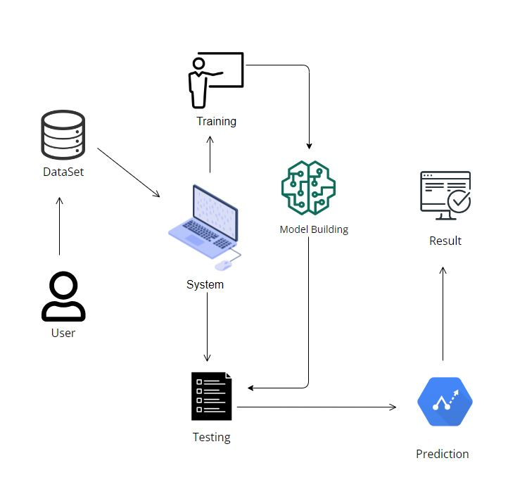
ARCHITECTURE DIAGRAM

Slide 16
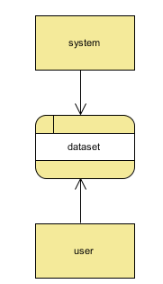
DATA FLOW DIAGRAM

Slide 17
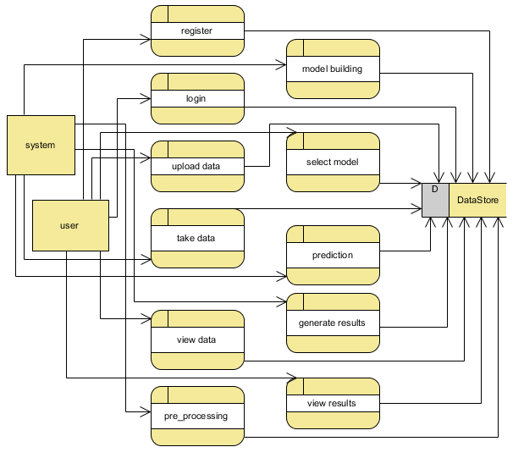
Level 1 Diagram:

Slide 18
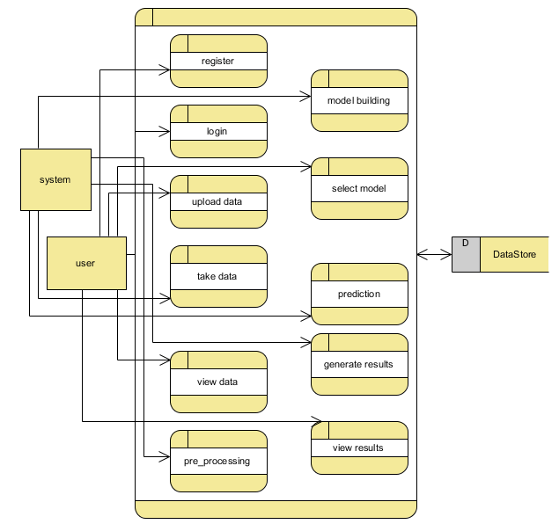
Level 2 Diagram:

Slide 19
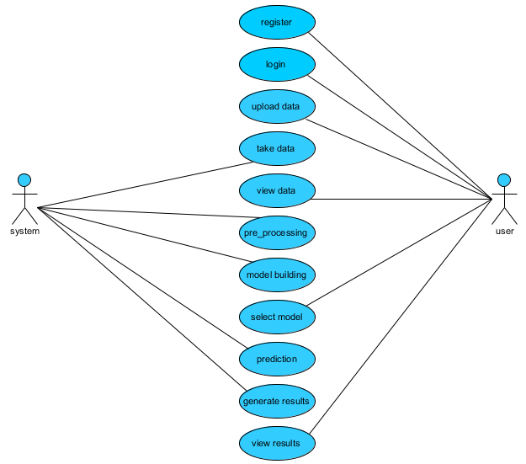
USE CASE DIAGRAM

Slide 20
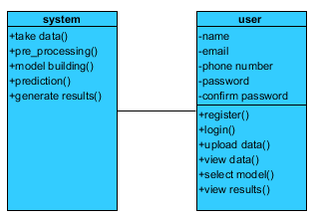
CLASS DIAGRAM

Slide 21
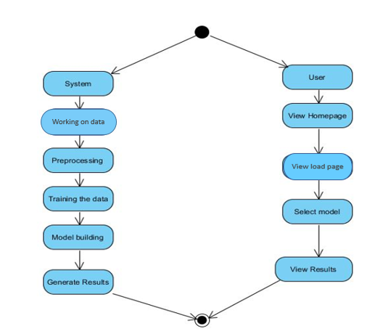
ACTIVITY DIAGRAM

Slide 22
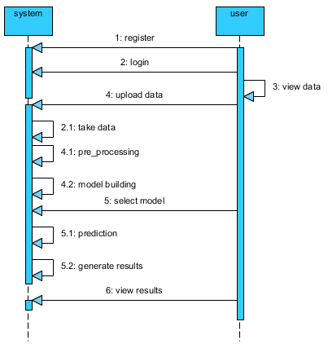
SEQUENCE DIAGRAM

Slide 23
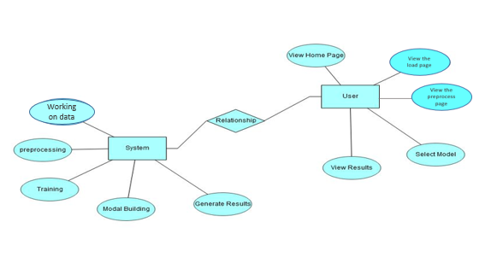
E-R DIAGRAM

Slide 24
CONCLUSION
This study showcases the potential of machine learning algorithms—Decision Tree, Random Forest, and Naive Bayes—in diagnosing anemia using eye-related data. The models exhibited promising accuracy, unveiling a link between ocular parameters and anemia status. These findings suggest a non-invasive, efficient approach for early anemia detection, providing healthcare professionals with valuable insights for enhanced diagnostic tools. Leveraging these predictive models could revolutionize screening methods, enabling timely interventions and significantly impacting global health outcomes. Incorporating diverse eye conditions into diagnostic protocols could pave the way for more accessible and effective healthcare strategies in combating anemia worldwide

Slide 25
REFERENCES
[1] E. Beutler, ‘‘The definition of anemia: What is the lower limit of normal of the blood hemoglobin concentration?’’ Blood, vol. 107, no. 5, pp. 1747–1750, 2006. doi: 10.1182/blood-2005-07-3046.
[2] M. Nelson, ‘‘Anaemia in adolescent girls: Effects on cognitive function and activity,’’ Proc. Nutrition Soc., vol. 55, no. 1B, pp. 359–367, 1996. doi: 10.1079/pns19960035.
[3] Assessing the Iron Status of Populations, Report of a Joint World Health Organization/Centers for Disease Control and Prevention, Geneva, Switzerland, 2004.
[4] B. de Benoist, E. McLean, I. Egli, and M. Cogswell, Eds., ‘‘Worldwide prevalence of anemia 1993-2005,’’ WHO Global Database Anaemia, Geneva, Switzerland, 2008.
[5] E. McLean, ‘‘WHO vitamin and mineral nutrition information system,’’ Worldwide Prevalence of Anaemia, Tech. Rep., 2008.

Slide 26
REFERENCES
[6] WHO.Accessed:May1,2018.[Online].Available: ttp://www.who.int/nutrition/topics/ida/en/
[7] The World Health Report 2002: Reducing Risks, Promoting Healthy Life, World Health Organization, Geneva, Switzerland, 2002.
[8] J. D. Cook, C. H. Flowers, and B. S. Skikne ‘‘The quantitative assessment of body iron,’’ Blood, vol. 101, no. 9, pp. 3359–3364, 2003.
[9] M. J. Koury, Red Blood Cell Production and Kinetics. London, U.K.: Wiley, 2016. doi: 10.1002/9781119013020.ch08.
[10] A. Porwit, J. McCullough, and W. N. Erber, Blood and Bone Marrow Pathology. Edinburgh, Scotland: Elsevier, 2011.

Slide 27
THANK YOU

